Slide 1


3.4 Hash Tables
Algorithms
Robert Sedgewick | Kevin Wayne
hash functions
separate chaining
linear probing
context
http://algs4.cs.princeton.edu
Notes:
[wayne f11] include memory of separate chaining and linear probing vs. red-black BST?

Slide 2
Symbol table implementations: summary
Q. Can we do better?
A. Yes, but with different access to the data.
implementation | guarantee |  |  | average case |  |  | ordered ops? | key interface
 | search | insert | delete | search hit | insert | delete
sequential search (unordered list) | N | N | N | ½ N | N | ½ N |  | equals()
binary search (ordered array) | lg N | N | N | lg N | ½ N | ½ N | ✔ | compareTo()
BST | N | N | N | 1.39 lg N | 1.39 lg N | √ N | ✔ | compareTo()
red-black BST | 2 lg N | 2 lg N | 2 lg N | 1.0 lg N | 1.0 lg N | 1.0 lg N | ✔ | compareTo()

Slide 3
Hashing: basic plan
Save items in a key-indexed table (index is a function of the key).
Hash function. Method for computing array index from key.
Issues.
Computing the hash function.
Equality test: Method for checking whether two keys are equal.
Collision resolution: Algorithm and data structure to handle two keys that hash to the same array index.
Classic space-time tradeoff.
No space limitation: trivial hash function with key as index.
No time limitation: trivial collision resolution with sequential search.
Space and time limitations: hashing (the real world).
0
1
2
3 | "it"
4
5
hash("it") = 3
??
hash("times") = 3
Notes:
hashing at its core is a space-time tradeoff: if our keys are 32-bit integers, can use a hash table of size 2^32

Slide 4
Hashing: basic plan
Why not use keys as index
0
1
2
3 | "it"
4
5
Notes:
hashing at its core is a space-time tradeoff: if our keys are 32-bit integers, can use a hash table of size 2^32

Slide 5
Hashing: basic plan
Why not use keys as index : Time-space tradeoff
0
1
2
3 | "it"
4
5
Notes:
hashing at its core is a space-time tradeoff: if our keys are 32-bit integers, can use a hash table of size 2^32

Slide 6

3.4 Hash Tables
hash functions
separate chaining
linear probing
context
http://algs4.cs.princeton.edu

Slide 7
Computing the hash function
Idealistic goal. Scramble the keys uniformly to produce a table index.
Efficiently computable.
Each table index equally likely for each key.
Ex 1. Phone numbers.
Bad: first three digits.
Better: last three digits.
Ex 2. Social Security numbers.
Bad: first three digits.
Better: last three digits.
Practical challenge. Need different approach for each key type.
key
thoroughly researched problem,
still problematic in practical applications
table
index
573 = California, 574 = Alaska (assigned in chronological order within geographic region)
Notes:
Goal: hash function scrambles keys, then each index will correspond to roughly 1/M fraction of elements
Assumes table size is M = 1000 (3 decimal digits)

Slide 8
Java’s hash code conventions
All Java classes inherit a method hashCode(), which returns a 32-bit int.
Requirement. If x.equals(y), then (x.hashCode() == y.hashCode()).
Highly desirable. If !x.equals(y), then (x.hashCode() != y.hashCode()).
Default implementation. Memory address of x.
Legal (but poor) implementation. Always return 17.
Customized implementations. Integer, Double, String, File, URL, Date, …
User-defined types. Users are on their own.
x
y
x.hashCode()
y.hashCode()
Notes:
int between -2^31 and 2^31 - 1
repeated calls to hashCode() must return same value (provided no info used in equals() is changed)
Ensures hashing can be used for every object type.
Enables expert implementations for each type. This is the sweet spot for hashing.

Slide 9
Implementing hash code: integers, booleans, and doubles
Java library implementations
public final class Integer
{
private final int value;
...
public int hashCode()
{ return value; }
}
public final class Double
{
private final double value;
...
public int hashCode()
{
long bits = doubleToLongBits(value);
return (int) (bits ^ (bits >>> 32));
}
}
public final class Boolean
{
private final boolean value;
...
public int hashCode()
{
if (value) return 1231;
else return 1237;
}
}
convert to IEEE 64-bit representation; xor most significant 32-bits with least significant 32-bits
Warning: -0.0 and +0.0 have different hash codes
Notes:
Java library implementations
Warning: this means that need special care when implementing equals(). The equals() method in Double considers -0.0 and 0.0 to be not equal even though 0.0 == -0.0

Slide 10
Implementing hash code: strings
Java library implementation
Horner's method to hash string of length L: L multiplies/adds.
Equivalent to h = s[0] · 31^{L–1} + … + s[L – 3] · 31² + s[L – 2] · 31¹ + s[L – 1] · 31⁰.
Ex.
public final class String
{
private final char[] s;
...
public int hashCode()
{
int hash = 0;
for (int i = 0; i < length(); i++)
hash = s[i] + (31 * hash);
return hash;
}
}
char | Unicode
… | …
'a' | 97
'b' | 98
'c' | 99
… | ...
i^{th} character of s
String s = "call"; int code = s.hashCode();
3045982 = 99·31³ + 97·31² + 108·31¹ + 108·31⁰
= 108 + 31· (108 + 31 · (97 + 31 · (99)))
(Horner's method)
Notes:
Note: reference Java implementation caches string hash codes.
this is essentially Java's implementation of hashCode() for strings since Java 1.5.
It's ok to add an int and a char. It's also ok if the result overflows since this is all well-defined in java. (two's complement integers)
Why 31? It's a Mersenne prime (one less than a power of 2) -> easy to implement with shift and subtract 1.

Slide 11
Implementing hash code: strings
Performance optimization.
Cache the hash value in an instance variable.
Return cached value.
Q. What if hashCode() of string is 0?
public final class String
{
private int hash = 0;
private final char[] s;
...
public int hashCode()
{
int h = hash;
if (h != 0) return h;
for (int i = 0; i < length(); i++)
h = s[i] + (31 * h);
hash = h;
return h;
}
}
cache of hash code
return cached value
store cache of hash code
Notes:
Note: if hash value is 0, it is recomputed every time, e.g., "pollinating sandboxes"
The code is a bit verbose in case threads are calling hashCode() concurrently
Another place where caching a value is useful is on 8-puzzle assignment - cache the manhattan distance in Board (or SearchNode)
Note: still immutable even though instance variable hash can change.

Slide 12
Implementing hash code: user-defined types
public final class Transaction implements Comparable<Transaction>
{
private final String who;
private final Date when;
private final double amount;
public Transaction(String who, Date when, double amount)
{ /* as before */ }
...
public boolean equals(Object y) { /* as before */ }
public int hashCode()
{
int hash = 17;
hash = 31*hash + who.hashCode();
hash = 31*hash + when.hashCode();
hash = 31*hash + ((Double) amount).hashCode();
return hash;
}
}
nonzero constant
for reference types,
use hashCode()
for primitive types, use hashCode() of wrapper type
typically a small prime
Notes:
the 17 helps reduce collisions when there are leading fields with 0s. Java often uses 1 as the constant instead of 17.

Slide 13
Hash code design
"Standard" recipe for user-defined types.
Combine each significant field using the Prime*Value + Prime rule.
In practice. Recipe works reasonably well; used in Java libraries.
In theory. Keys are bitstring; "universal" hash functions exist.
Basic rule. Need to use the whole key to compute hash code; consult an expert for state-of-the-art hash codes.
Notes:
used in Java libraries such as Arrays.deepHashCode() and String
Note: Java makes it difficult to implement universal hashing and tabular hashing because there is only one hash function (from hashCode())

Slide 14
Modular hashing
Hash code. An int between -2³¹ and 2³¹ - 1.
Hash function. An int between 0 and M - 1 (for use as array index).
typically a prime or power of 2
x
private int hash(Key key)
{ return key.hashCode() % M; }
bug
x.hashCode()
private int hash(Key key)
{ return Math.abs(key.hashCode()) % M; }
1-in-a-billion bug
hash(x)
hashCode() of "polygenelubricants" is −2³¹
private int hash(Key key)
{ return (key.hashCode() & 0x7fffffff) % M; }
correct
Notes:
int between -2^32 and 2^31 - 1
Can't use h % M for index since h can be negative so % can return negative number. Plausible fix |h| % M doesn't work since |h| can be negative if h = -2^31. Should also count 1 bit-whacking operation in work to hash string of length W.

Slide 15
Uniform hashing assumption
Uniform hashing assumption. Each key is equally likely to hash to an integer between 0 and M − 1.
Bins and balls. Throw balls uniformly at random into M bins.
Birthday problem. Expect two balls in the same bin after ~ π M / 2 tosses.
Coupon collector. Expect every bin has ≥ 1 ball after ~ M ln M tosses.
Load balancing. After M tosses, expect most loaded bin has Θ ( log M / log log M ) balls.
0 | 1 | 2 | 3 | 4 | 5 | 6 | 7 | 8 | 9 | 10 | 11 | 12 | 13 | 14 | 15
Notes:
Ex. After 23 people enter a room, expect two with same birthday.

Slide 16
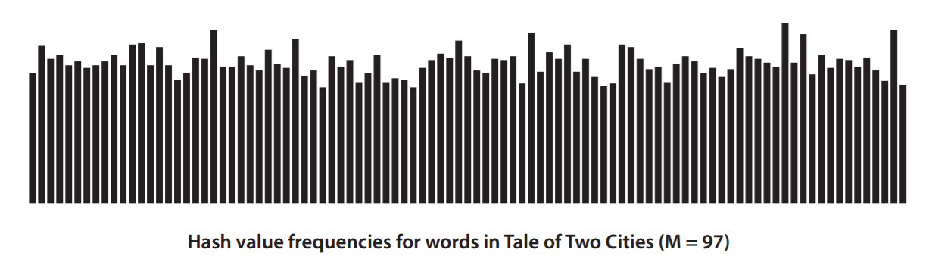
Uniform hashing assumption
Uniform hashing assumption. Each key is equally likely to hash to an integer between 0 and M − 1.
Bins and balls. Throw balls uniformly at random into M bins.
0 | 1 | 2 | 3 | 4 | 5 | 6 | 7 | 8 | 9 | 10 | 11 | 12 | 13 | 14 | 15

Slide 17
3.4 Hash Tables
hash functions
separate chaining
linear probing
context
http://algs4.cs.princeton.edu

Slide 18
3.4 Hash Tables
hash functions
separate chaining
linear probing
context
http://algs4.cs.princeton.edu

Slide 19
Collisions
Collision. Two distinct keys hashing to same index.
Birthday problem −> can't avoid collisions unless you have a ridiculous (quadratic) amount of memory.
Coupon collector + load balancing −> collisions are evenly distributed.
Challenge. Deal with collisions efficiently.
0
1
2
3 | "it"
4
5
hash("it") = 3
??
hash("times") = 3

Slide 20
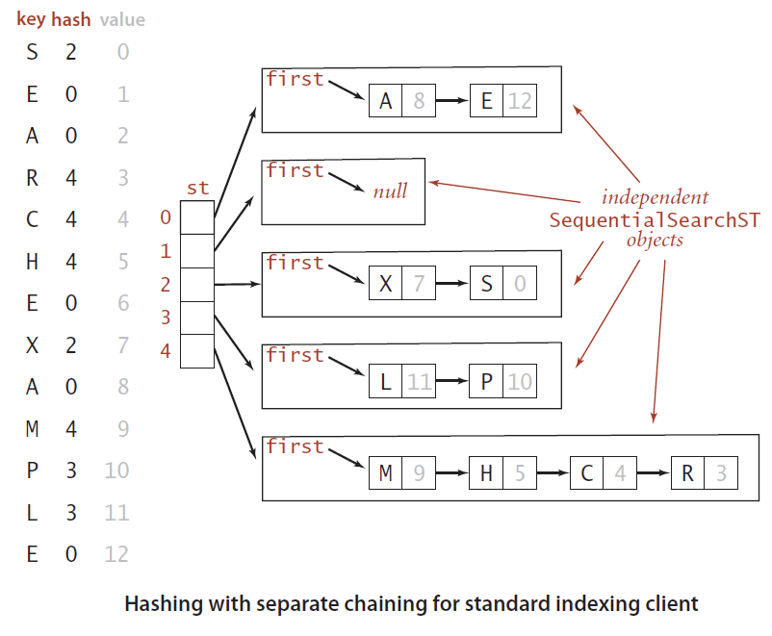
Separate-chaining symbol table
Use an array of M < N linked lists. [H. P. Luhn, IBM 1953]
Hash: map key to integer i between 0 and M − 1.
Insert: put at front of i^{th} chain (if not already there).
Search: need to search only i^{th} chain.
Notes:
[wayne f12] add a demo?
[wayne f11] Note that textbook uses array of SequentialSearchST symbol tables instead of implementing linked lists from scratch

Slide 21
Separate-chaining symbol table: Java implementation
public class SeparateChainingHashST<Key, Value> { private int M = 97; // number of chains private Node[] st = new Node[M]; // array of chains
private static class Node
{
private Object key;
private Object val;
private Node next;
...
}
private int hash(Key key) { return (key.hashCode() & 0x7fffffff) % M; }
public Value get(Key key) {
int i = hash(key);
for (Node x = st[i]; x != null; x = x.next)
if (key.equals(x.key)) return (Value) x.val;
return null;
}
}
array doubling and halving code omitted
no generic array creation
(declare key and value of type Object)
Notes:
cast needed because of generic array creation problem in Java

Slide 22
Separate-chaining symbol table: Java implementation
public class SeparateChainingHashST<Key, Value> { private int M = 97; // number of chains private Node[] st = new Node[M]; // array of chains
private static class Node
{
private Object key;
private Object val;
private Node next;
...
}
private int hash(Key key) { return (key.hashCode() & 0x7fffffff) % M; }
public void put(Key key, Value val) {
int i = hash(key);
for (Node x = st[i]; x != null; x = x.next)
if (key.equals(x.key)) { x.val = val; return; }
st[i] = new Node(key, val, st[i]);
}
}

Slide 23
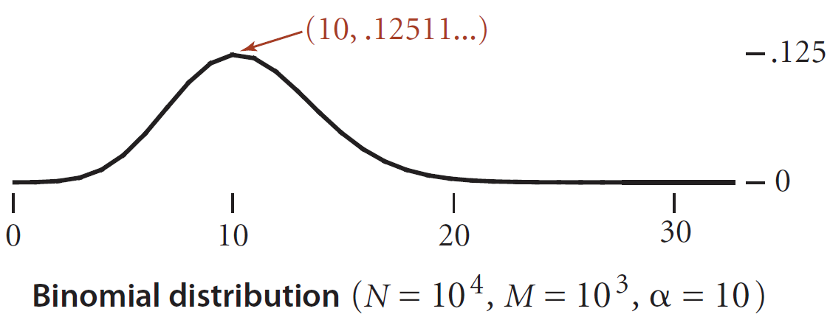
Analysis of separate chaining
M is size of array, number of bins; N is numbers of keys
Proposition. Under uniform hashing assumption, prob. that the number of keys in a list is within a constant factor of N / M is extremely close to 1.
Pf sketch. Distribution of list size obeys a binomial distribution.
Consequence. Number of probes for search/insert is proportional to N / M.
M too large −> too many empty chains.
M too small −> chains too long.
Typical choice: M ~ N / 4 ⇒ constant-time ops.
M times faster than sequential search
Notes:
Distribution concentrated around its mean (variance = N/M - N/M^2 ~ N/M)
Cost is proportional to length of chain.
Worst case. All keys hash to same list => N time per search/insert.

Slide 24
Resizing in a separate-chaining hash table
Goal. Average length of list N / M = constant.
Double size of array M when N / M ≥ 8.
Halve size of array M when N / M ≤ 2.
Need to rehash all keys when resizing.
before resizing
st[]
A
B
C
D
E
F
G
H
I
J
0
1
K
L
M
N
O
P
after resizing
st[]
K
I
0
P
N
L
E
A
1
2
J
F
C
B
3
O
M
H
G
D

Slide 25
Deletion in a separate-chaining hash table
Q. How to delete a key (and its associated value)?
A. Easy: need only consider chain containing key.
before deleting C
after deleting C
st[]
K
I
st[]
K
I
0
P
N
L
0
P
N
L
1
1
2
J
F
C
B
2
J
F
B
3
3
O
M
O
M

Slide 26
Symbol table implementations: summary
implementation | guarantee |  |  | average case |  |  | ordered ops?
 | search | insert | delete | search hit | insert | delete
sequential search (unordered list) | N | N | N | ½ N | N | ½ N
binary search (ordered array) | lg N | N | N | lg N | ½ N | ½ N | ✔
BST | N | N | N | 1.39 lg N | 1.39 lg N | √ N | ✔
red-black BST | 2 lg N | 2 lg N | 2 lg N | 1.0 lg N | 1.0 lg N | 1.0 lg N | ✔
separate chaining | N | N | N | 3-5 * | 3-5 * | 3-5 *
* under uniform hashing assumption
Notes:
The worst case is the bound from the load balancing problem - the length of the longest chain is expected to be about log N / log log N

Slide 27
3.4 Hash Tables
hash functions
separate chaining
linear probing
context
http://algs4.cs.princeton.edu

Slide 28
3.4 Hash Tables
hash functions
separate chaining
linear probing
context
http://algs4.cs.princeton.edu

Slide 29
Collision resolution: open addressing
Open addressing. [Amdahl-Boehme-Rocherster-Samuel, IBM 1953] When a new key collides, find next empty slot, and put it there.
- To store N key-value pairs in a hash table of size M > N,
st[0]
jocularly
st[1]
null
st[2]
listen
st[3]
suburban
null
st[30000]
browsing
linear probing (M = 30001, N = 15000)

Slide 30

Linear-probing hash table demo
Hash. Map key to integer i between 0 and M-1.
Insert. Put at table index i if free; if not try i+1, i+2, etc.
linear-probing hash table
0
1
2
3
4
5
6
7
8
9
10
11
12
13
14
15
st[]
M = 16
Notes:
34DemoLinearProbingHashTable.key

Slide 31
Linear-probing hash table demo
Hash. Map key to integer i between 0 and M-1.
Search. Search table index i; if occupied but no match, try i+1, i+2, etc.
K
search
hash(K) = 5
0
1
2
3
4
5
6
7
8
9
10
11
12
13
14
15
st[]
P
M
A
C
S
H
L
E
R
X
K
M = 16
search miss
(return null)

Slide 32
Linear-probing hash table summary
Hash. Map key to integer i between 0 and M-1.
Insert. Put at table index i if free; if not try i+1, i+2, etc.
Search. Search table index i; if occupied but no match, try i+1, i+2, etc.
Note. Array size M must be greater than number of key-value pairs N.
0
1
2
3
4
5
6
7
8
9
10
11
12
13
14
15
st[]
P
M
A
C
S
H
L
E
R
X
M = 16

Slide 33
Linear-probing symbol table: Java implementation
public class LinearProbingHashST<Key, Value>
{
private int M = 30001;
private Value[] vals = (Value[]) new Object[M];
private Key[] keys = (Key[]) new Object[M];
private int hash(Key key) { /* as before */ }
private void put(Key key, Value val) { /* next slide */ }
public Value get(Key key)
{
for (int i = hash(key); keys[i] != null; i = (i+1) % M)
if (key.equals(keys[i]))
return vals[i];
return null;
}
}
array doubling and halving code omitted
Notes:
a bit faster if you use if (i == M) i = 0; to avoid (i % M) calculation

Slide 34
Linear-probing symbol table: Java implementation
public class LinearProbingHashST<Key, Value>
{
private int M = 30001;
private Value[] vals = (Value[]) new Object[M];
private Key[] keys = (Key[]) new Object[M];
private int hash(Key key) { /* as before */ }
private Value get(Key key) { /* previous slide */ }
public void put(Key key, Value val)
{
int i;
for (i = hash(key); keys[i] != null; i = (i+1) % M)
if (keys[i].equals(key))
break;
keys[i] = key;
vals[i] = val;
}
}
Notes:
similar to put

Slide 35
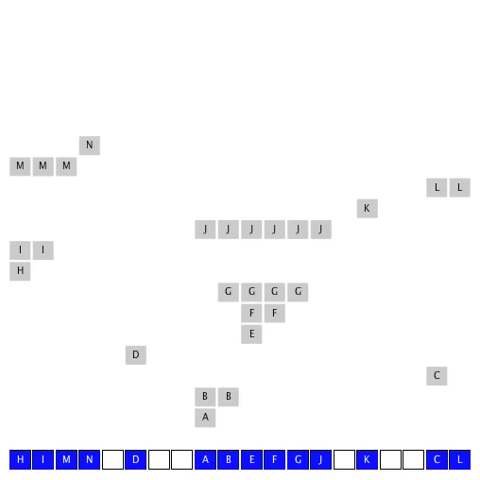
Clustering
Cluster. A contiguous block of items.
Observation. New keys likely to hash into middle of big clusters.

Slide 36
Knuth's parking problem
Model. Cars arrive at one-way street with M parking spaces. Each desires a random space i : if space i is taken, try i + 1, i + 2, etc.
Q. What is mean displacement of a car?
Half-full. With M / 2 cars, mean displacement is ∼ 3 / 2.
Full. With M cars, mean displacement is ∼ M / 8 .
displacement = 3
Notes:
http://portal.acm.org/citation.cfm?id=1103965
1/4 sqrt(2 pi * M) + 1/3 + 1/48 sqrt(2 pi / M) + O(1/M)
1/2 (1 + 1 / (1 - alpha)) - 1 / ((2 (1 - alpha)^3) M)) + O(1/M^2) for typical values of alpha
mean displacement = time for search hit
Lesson: don't fill up linear probing hash table!

Slide 37


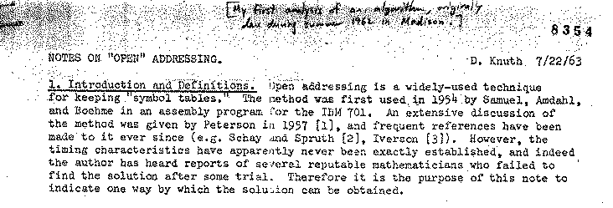

Analysis of linear probing
Proposition. Under uniform hashing assumption, the average # of probes in a linear probing hash table of size M that contains N = αM keys is:
Pf.
Parameters.
M too large , too many empty array entries.
M too small , search time blows up.
Typical choice: α = N / M ~ ½.
search hit
search miss / insert
# probes for search hit is about 3/2
# probes for search miss is about 5/2
Notes:
Knuth: "my first analysis of algorithms, originally done during summer 1962 in Madison"
A landmark in analysis of algorithms
when table is 90% full, search miss takes about 101/2 probes
estimates only accurate when alpha isn't too close to 1
depends on sum of squares of cluster lengths (which is formed by complex dynamic process)

Slide 38
Resizing in a linear-probing hash table
Goal. Average length of list N / M ≤ ½.
Double size of array M when N / M ≥ ½.
Halve size of array M when N / M ≤ ⅛.
Need to rehash all keys when resizing.
before resizing
0 | 1 | 2 | 3 | 4 | 5 | 6 | 7
 | E | S |  |  | R | A
 | 1 | 0 |  |  | 3 | 2
keys[]
vals[]
after resizing
0 | 1 | 2 | 3 | 4 | 5 | 6 | 7 | 8 | 9 | 10 | 11 | 12 | 13 | 14 | 15
 |  |  |  | A |  | S |  |  |  | E |  |  |  | R
 |  |  |  | 2 |  | 0 |  |  |  | 1 |  |  |  | 3
keys[]
vals[]

Slide 39
Deletion in a linear-probing hash table
Q. How to delete a key (and its associated value)?
A. Requires some care: can't just delete array entries.
before deleting S
0 | 1 | 2 | 3 | 4 | 5 | 6 | 7 | 8 | 9 | 10 | 11 | 12 | 13 | 14 | 15
P | M |  |  | A | C | S | H | L |  | E |  |  |  | R | X
10 | 9 |  |  | 8 | 4 | 0 | 5 | 11 |  | 12 |  |  |  | 3 | 7
keys[]
vals[]
doesn't work, e.g., if hash(H) = 4
after deleting S ?
0 | 1 | 2 | 3 | 4 | 5 | 6 | 7 | 8 | 9 | 10 | 11 | 12 | 13 | 14 | 15
P | M |  |  | A | C |  | H | L |  | E |  |  |  | R | X
10 | 9 |  |  | 8 | 4 |  | 5 | 11 |  | 12 |  |  |  | 3 | 7
keys[]
vals[]
Notes:
Option 1: tombstone entry 6 (allow it to be used for insertion, but skipped over for serach).
Option 2: rehash all keys in cluster after deleted key.

Slide 40
ST implementations: summary
implementation | guarantee |  |  | average case |  |  | ordered ops? | key interface
 | search | insert | delete | search hit | insert | delete
sequential search (unordered list) | N | N | N | ½ N | N | ½ N |  | equals()
binary search (ordered array) | lg N | N | N | lg N | ½ N | ½ N | ✔ | compareTo()
BST | N | N | N | 1.39 lg N | 1.39 lg N | √ N | ✔ | compareTo()
red-black BST | 2 lg N | 2 lg N | 2 lg N | 1.0 lg N | 1.0 lg N | 1.0 lg N | ✔ | compareTo()
separate chaining | N | N | N | 3-5 * | 3-5 * | 3-5 * |  | equals() hashCode()
linear probing | N | N | N | 3-5 * | 3-5 * | 3-5 * |  | equals() hashCode()
* under uniform hashing assumption

Slide 41
3.4 Hash Tables
hash functions
separate chaining
linear probing
context
http://algs4.cs.princeton.edu

Slide 42
3.4 Hash Tables
hash functions
separate chaining
linear probing
context
http://algs4.cs.princeton.edu

Slide 43
War story: algorithmic complexity attacks
Q. Is the uniform hashing assumption important in practice?
A. Obvious situations: aircraft control, nuclear reactor, pacemaker.
A. Surprising situations: denial-of-service attacks.
Real-world exploits. [Crosby-Wallach 2003]
Bro server: send carefully chosen packets to DOS the server, using less bandwidth than a dial-up modem.
Perl 5.8.0: insert carefully chosen strings into associative array.
Linux 2.4.20 kernel: save files with carefully chosen names.
st[]
0
1
2
3
malicious adversary learns your hash function (e.g., by reading Java API) and causes a big pile-up in single slot that grinds performance to a halt
4
5
6
7
Notes:
we take little solace in knowing that we encountered a statistically insignificant event.
http://www.cs.rice.edu/~scrosby/hash

Slide 44
War story: String hashing in Java
String hashCode() in Java 1.1.
For long strings: only examine 8-9 evenly spaced characters.
Benefit: saves time in performing arithmetic.
Downside: great potential for bad collision patterns.
public int hashCode()
{
int hash = 0;
int skip = Math.max(1, length() / 8);
for (int i = 0; i < length(); i += skip)
hash = s[i] + (37 * hash);
return hash;
}
http://www.cs.princeton.edu/introcs/13loop/Hello.java
http://www.cs.princeton.edu/introcs/13loop/Hello.class
http://www.cs.princeton.edu/introcs/13loop/Hello.html
http://www.cs.princeton.edu/introcs/12type/index.html
Notes:
Java 1.1: only considered 8 characters, evenly spaced starting at beginning. Intent was for speed, but ended up creating performance problems because of bad collision patterns. (See complexity attacks later in lecture)

Slide 45
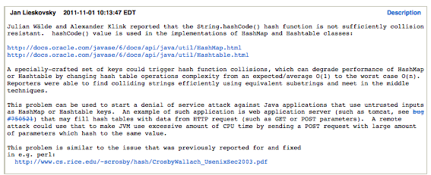
War story: algorithmic complexity attacks
A Java bug report.

Slide 46
Algorithmic complexity attack on Java
Goal. Find family of strings with the same hash code.
Solution. The base-31 hash code is part of Java's string API.
key | hashCode()
"Aa" | 2112
"BB" | 2112
key | hashCode()
"AaAaAaAa" | -540425984
"AaAaAaBB" | -540425984
"AaAaBBAa" | -540425984
"AaAaBBBB" | -540425984
"AaBBAaAa" | -540425984
"AaBBAaBB" | -540425984
"AaBBBBAa" | -540425984
"AaBBBBBB" | -540425984
key | hashCode()
"BBAaAaAa" | -540425984
"BBAaAaBB" | -540425984
"BBAaBBAa" | -540425984
"BBAaBBBB" | -540425984
"BBBBAaAa" | -540425984
"BBBBAaBB" | -540425984
"BBBBBBAa" | -540425984
"BBBBBBBB" | -540425984
2^{N} strings of length 2N that hash to same value!
Notes:
Alternative 1: hide details of String hashCode(), This is security-by-obscurity
Alternate 2: use different data structure that guarantees performance
Note: java cache string hash function, but only if it is not zero.

Slide 47
Diversion: one-way hash functions
One-way hash function. "Hard" to find a key that will hash to a desired value (or two keys that hash to same value).
Ex. MD4, MD5, SHA-0, SHA-1, SHA-2, WHIRLPOOL, RIPEMD-160, ….
Applications. Digital fingerprint, message digest, storing passwords.
Caveat. Too expensive for use in ST implementations.
known to be insecure
String password = args[0];
MessageDigest sha1 = MessageDigest.getInstance("SHA1");
byte[] bytes = sha1.digest(password);
/* prints bytes as hex string */
Notes:
SHA-1 has 160-bit output
[wayne f11] should we discuss universal hashing here too?

Slide 48
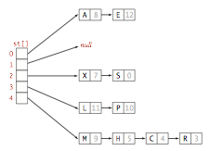
Separate chaining vs. linear probing
Separate chaining.
Performance degrades gracefully.
Clustering less sensitive to poorly-designed hash function.
Linear probing.
Less wasted space.
Better cache performance.
0 | 1 | 2 | 3 | 4 | 5 | 6 | 7 | 8 | 9 | 10 | 11 | 12 | 13 | 14 | 15
P | M |  |  | A | C | S | H | L |  | E |  |  |  | R | X
10 | 9 |  |  | 8 | 4 | 0 | 5 | 11 |  | 12 |  |  |  | 3 | 7
keys[]
vals[]
Notes:
Delete is easy in a separate chaining hash table.

Slide 49

Hashing: variations on the theme
Many improved versions have been studied.
Two-probe hashing. [ separate-chaining variant ]
Hash to two positions, insert key in shorter of the two chains.
Reduces expected length of the longest chain to log log N.
Double hashing. [ linear-probing variant ]
Use linear probing, but skip a variable amount, not just 1 each time.
Effectively eliminates clustering.
Can allow table to become nearly full.
More difficult to implement delete.
Cuckoo hashing. [ linear-probing variant ]
Hash key to two positions; insert key into either position; if occupied, reinsert displaced key into its alternative position (and recur).
Constant worst-case time for search.
Notes:
cuckoo hashing: may need to rebuild entire table (using new hash functions) if infinite loop in displacement. Insertion is constant expected time as long as table is at most half full.

Slide 50
Hash tables vs. balanced search trees
Hash tables.
Simpler to code.
No effective alternative for unordered keys.
Faster for simple keys (a few arithmetic ops versus log N compares).
Better system support in Java for strings (e.g., cached hash code).
Balanced search trees.
Stronger performance guarantee.
Support for ordered ST operations.
Easier to implement compareTo() correctly than equals() and hashCode().
Notes:
Does your hash function produce random values for your key type??
java.util.HashMap uses separate chaining, java.util.IdentityHashMap uses linear probing

Slide 51
3.4 Hash Tables
hash functions
separate chaining
linear probing
context
http://algs4.cs.princeton.edu

Slide 52
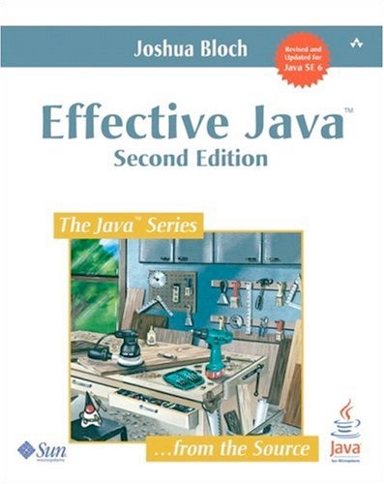
Optimize judiciously
“ More computing sins are committed in the name of efficiency
(without necessarily achieving it) than for any other single reason—
including blind stupidity. ” — William A. Wulf
“ We should forget about small efficiencies, say about 97% of the time:
premature optimization is the root of all evil. ” — Donald E. Knuth
“ We follow two rules in the matter of optimization:
Rule 1: Don't do it.
Rule 2 (for experts only). Don't do it yet - that is, not until you have a perfectly clear and unoptimized solution. ” — M. A. Jackson
Reference: Effective Java by Joshua Bloch
Notes:
[wayne f11] not sure this slide fits well here

Slide 53
3.4 Hash Tables
Algorithms
Robert Sedgewick | Kevin Wayne
hash functions
separate chaining
linear probing
context
http://algs4.cs.princeton.edu

